Slide 1
Banking Application
Final Presentation
Group 6

Slide 2
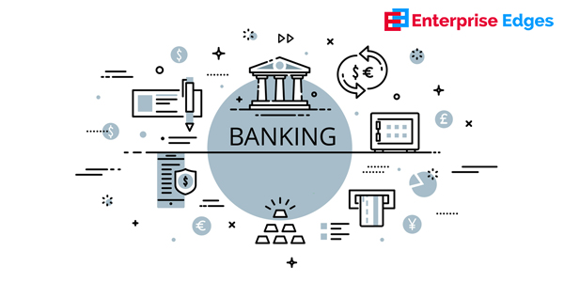
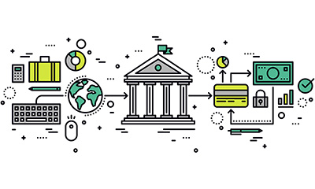
Group 6
Angela
Anthony
Ebadullah
Gurjas
Tuong

Slide 3
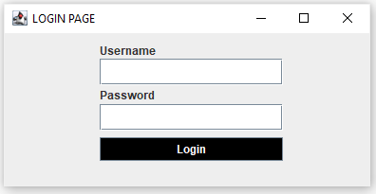
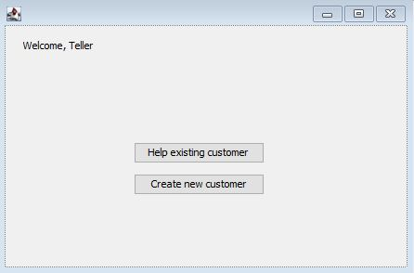
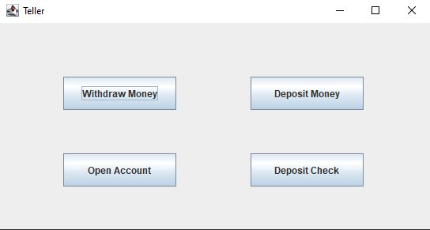

Components
Login
Checking
Savings
Teller
Client/Server

Slide 4
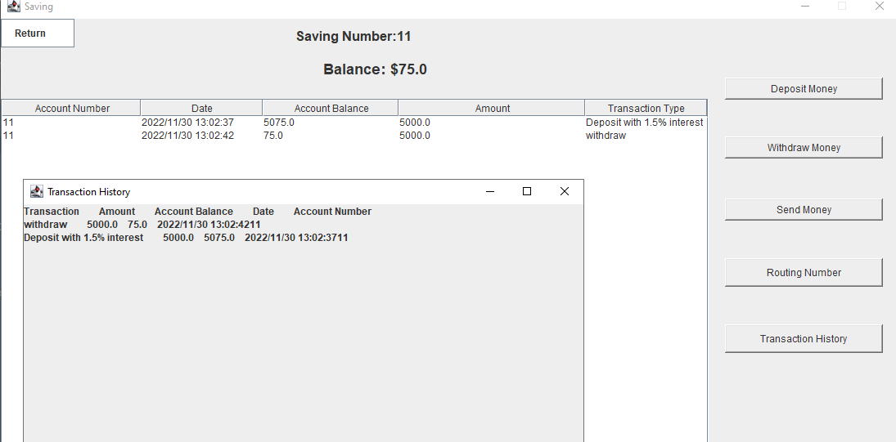
Project demo!

Slide 5
What didn’t go well
Schedules did not align much
Spent too much time on design compared to implementation
Confusion about who was working on what
Left out some functionality (ex: freezing a user account, credit limit, currency exchange)
Did not allocate much time for testing

Slide 6
What went well
Good communication via messaging when synchronous meetings were not possible
Team members helped out each other out when stuck
Good documentation of design, team meetings, testing
Solidified understanding of the development process
Met the requirements outlined in our revised SRS

Slide 7
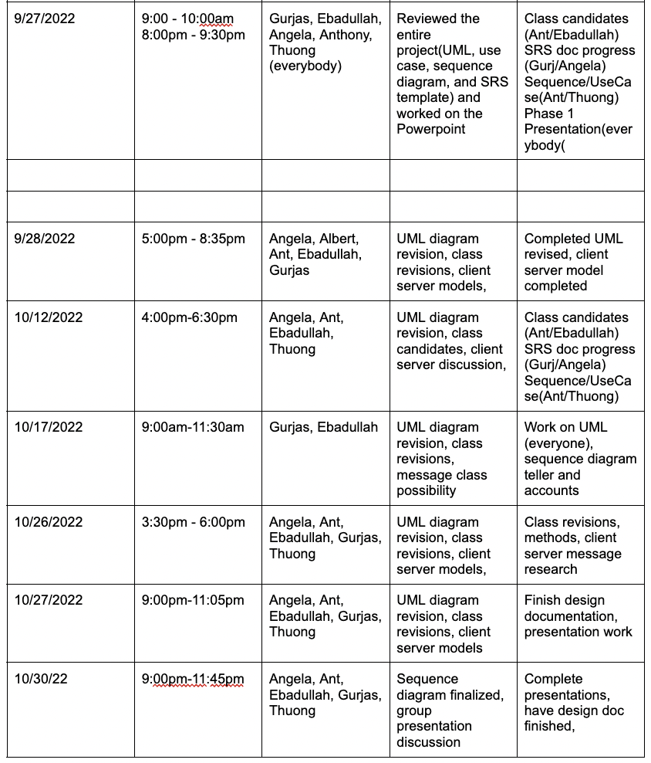
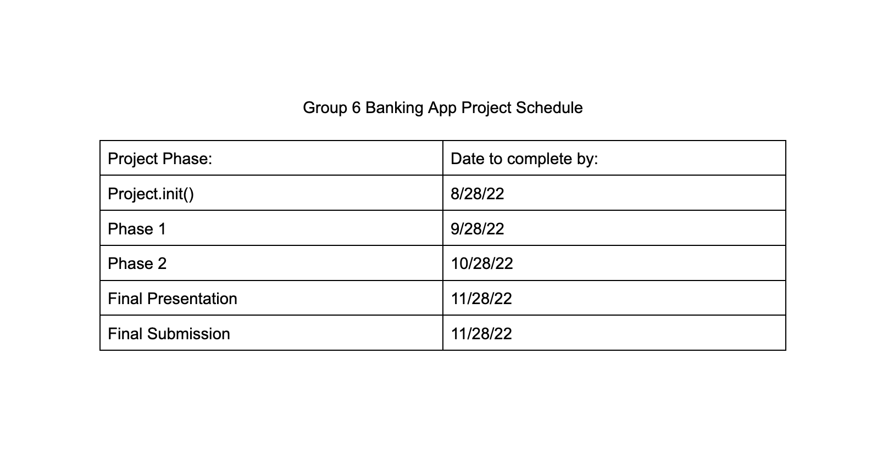
Project Schedule

Slide 8
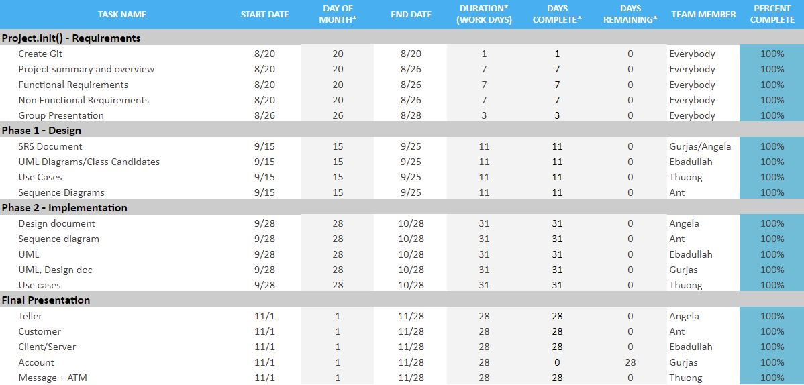
Project Progress

Slide 9
Git
https://github.com/hellogurjas/CS401_BankingProject.git

Slide 10
Thank you

